Slide 1

ICT Standardisation Policy: Framework, Challenges and Opportunities in the European Landscape
Francisco García Morán
European Commission
Chief IT Advisor
Madrid, 18 Noviembre 2013

Slide 2

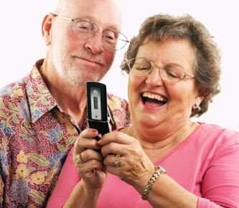






“Every European Digital”
Neelie Kroes
Trust and security
Very fast Internet
Digital Single Market
Research and innovation
Enhancing e-skills
ICT for social challenges
Interoperability and standards
Digital Single Market
Interoper. & standards
Trust & security
Very fast Internet
Research & Innovation
Enhancing e-skills
ICT for social challenges
Notes:
2
Digital Agenda SlidesDigital Agenda Slides
19/11/2013
Córdoba, Argentina, September 2011Córdoba, Argentina, September 2011
2
Digital Agenda Slides
19/11/2013
Córdoba, Argentina, September 2011
2
DAE
”The aim is to deliver sustainable economic and social benefits from a Single Market based on fast and ultra fast internet and interoperable applications .”
“ [The Member States invite the Commission to] further harness the potential of information and communication technologies […] within the Commission through the relevant strategies and action plans.” Ministerial Declaration on e-government. Malmö, Nov. 2009
4 axis:
User empowerment:
User driven services + Collaboration + Reusable information + Transparency + Participation
Single market:
Business mobility + Citizens mobility + Cross-border services
Efficiency and effectiveness
Administrative burden + Organisational Processes + Carbon footprint
Pre-conditions
Key enablers + Open specifications + Innovation
Granada Declaration reinforced above
Ghent – Citadel statement
The Citadel Statement will help local government deliver on the key objectives of the Malmo Ministerial Declaration.
Five core areas where European and national decision makers can provide tangible support to improve local eGovernment:
Common Architecture, Shared Services and Standards
Open Data, Transparency and Personal Rights. Show a commitment to making public data open and accessible
Citizen Participation and Involvement
Privacy and Identification of Individuals. Create a robust political and policy framework to address common privacy issues across Europe associated with personal data.
Rural Inclusion. Promote the concept of Broadband as a public utility that – like electricity and water – should be available to all communities no matter how small or geographically dispersed.

Slide 3

Interoperability and standards
Recognize and create more and better standards in Europe
Make better use of these
standards
Ensure interoperability even in absence of standards
Notes:
3
Policy goals
3

Slide 4




2010
Interoperability and standards
2011
2010
EIF
ICT
std
2011
new rules for ICT standards
EIF
stds eProc
Guidance on standards for eProc
2012
2011
MS to
apply
MS to apply EIF, Malmö & Granada commitments
2013
Notes:
4
2010: Propose new rules for ICT standards
2010: Adopt EIF
2011: Guidance on standards for eProc
2012: Examine measures for disclosing interoperability information
2013: MS to apply EIF, Malmö & Granada commitments
Action 21: Propose legislation on ICT interoperability
Action 22: Promote standard-setting rules
Action 23: Provide guidance on ICT standardisation and public procurement
Action 24: Adopt a European Interoperability Strategy and Framework
Action 25: Analyse the consequences of requesting significant market players to licence information
Action 26: Member States to implement European Interoperability Framework
Action 27: Member States to implement Malmö and Granada declarations
4

Slide 5
Global ICT Standardisation scene
IEC
ISO
ISO
ITU
  J T C 1
CENELEC
CEN
CEN
Small “private/ closed” fora and consortia
  ICT Forum
W 3 C
I E T F
I E E E
O G F
ETSI
Others...
O A S I S
National Bodies
National Bodies
(National Committees)
Covered by the European standardisation system of today
Outside of the scope of European standardisation – therefore not available for use in public procurement

Slide 6
Issues
A major part of ICT standardisation is done in global Fora & Consortia, outside the scope of the European standardisation system CEN/CENELEC/ETSI
These specifications are not directly available for referencing in public procurement
However:
The Digital Agenda for Europe underlines the need for interoperability. Fora & Consortia specifications are expected to contribute
Fora & Consortia specifications need to be available for Europe

Slide 7
Regulation (EU) 1025/2012
on European Standardisation

Slide 8
Standards are important
From research to production, from producer to consumer, from Europe to the rest of the world, European standards remove barriers, safeguard users, protect the environment, ensure interoperability, reduce costs and encourage competition. Studies show that standardisation adds between 0.3% and 1% to GDP thereby helping industry towards the target of contributing 20% of the EU’s GDP by 2020

Slide 9



Standards are important

Slide 10
Regulation (EU) 1025/2012 [I]
Consolidated legal basis for European standardisation which:
Repeals Decisions 87/95/EC and 1673/2006/EC
Amends several Directives, including Directive 98/34/EC
Entered into force on 1/1/2013

Slide 11
Regulation (EU) 1025/2012 [II]
Extends definitions and scope to services
Ensures cooperation between NSB on draft standards and work programmes (Articles 3-4)
Increases stakeholder participation
  An obligation for ESOs (Article 5)
  Financing of other European organisations (Article 16, criteria in Annex III)

Slide 12
Standards
EU Regulation 1025/2012 (amending Directive 98/34)3 (the Standardisation Regulation) defines a ‘standard’ as ‘a technical specification adopted by a recognised standardisation body, for repeated or continuous application, with which compliance is not compulsory, and which is one of the following:
• “international standard” means a standard adopted by an international standardisation body,
• “European standard” means a standard adopted by a European standardisation organisation,
• “harmonised standard” means a European standard adopted on the basis of a request made by the Commission for the application of Union harmonisation legislation;
• “national standard” means a standard adopted by a national standardisation body;’.

Slide 13
Open Specifications
According to the European Interoperability Framework v2 (COM(2010) 744), Open Specifications , which are essential for the setting up of Interoperability Agreements (the basis for the development of European Public Services) are characterised as follows
All stakeholders have the same possibility of contributing to the development of the specification and public review is part of the decision-making process;
The specification is available for everybody to study;
Intellectual Property Rights related to the specification are licensed on FRAND terms or on a royalty-free basis in a way that allows implementation in both proprietary and open source software
• •

Slide 14
Regulation (EU) 1025/2012 [III]
Identification of ICT technical specifications for public procurement (Articles 13 and 14)
  Proposals from Member States or Commission
  Multi-Stakeholder Platform to advise
  Criteria for identification (Annex II)
Committee to assist the Commission (Article 22)

Slide 15
European Multi-stakeholder Platform
on ICT Standardisation
[Commission Decision 2011/C 349/04]

Slide 16
European Multi-stakeholder Platform on ICT Standardisation
Mandate for three years
Participants : Member States, SDOs, industry, SMEs, societal organisations
Observers on case by case basis
Advice on implementation of ICT standardisation policy, work programme
Advice on selection and evaluation process in view of recognition of ICT technical specifications
Chair and secretariat: Commission services
Kick-off meeting: 26 March 2012

Slide 17
European Multi-stakeholder Platform on ICT Standardisation
1. The platform shall be composed of up to 67 members.
2. The members shall be the national authorities of Member States and EFTA countries and organisations representing ICT standardisation stakeholders appointed by the Commission as follows:
a) Up to 18 organisations representing industry, small and medium-sized enterprises and societal stakeholders,
b) Up to 14 European and international standardisation bodies and other nonprofit making organisations which are professional societies, industry or trade associations or other membership organisations active in Europe that within their area of expertise develop standards in the field of ICT.
3. The members referred to in 2(a) and (b) shall be appointed by the Directors-General of DG Enterprise and Industry and DG Information Society and Media on behalf of the Commission from relevant stakeholder organisations with the aim of achieving a balanced representation taking account of the tasks and expertise required.

Slide 18
The Rolling Plan for ICT Standardisation

Slide 19
The Rolling Plan for ICT Standardisation
Successor of the 2010-2013 ICT Standardisation Work Programme
Renamed to avoid confusion with the annual union work programme
Rolling plan = multiannual
Living document = no defined duration
Drafted by the Commission
Adviced by the Multi-stakeholder Platform on ICT Standardisation
Addressed to all ICT stakeholders (not only ESOs)

Slide 20
Content of the Rolling Plan
Actions to support policies :
  Linked to a EU policy
  Direct involvement of a defined Commission Service
  Examples: Intelligent Transport, eHealth, eInvoicing
Actions to support general interoperability:
  Not linked to a specific policy
  Not linked to a specific Commission Service
  Example: testing events

Slide 21



Standards for EU procurement
European Standardization Organizations
ETSI
Multi-stakeholder platform
CEN
ICT fora and consortia
CENELEC
Community and Stakeholders

Slide 22
Work Plan 2013 on ICT Standardisation
eHealth
RFID
eSkills and eLearning
eProcurement and eCatalogues
eInvoicing
On-Line Dispute Resolution (ODR) for eCommerce
The Internet of Things (IoT)
Electronic identification and trust services including electronic signatures
Card, internet and mobile payments
Intelligent Transport Systems (ITS)

Slide 23
Strategy
Framework
Guidelines
Infrastructure services
Legal
Organisational
Semantical
Technical
Notes:
Two elements:
EIS → 3 clusters + Accompanying measures
Cluster: Trusted information exchange
Semantic interoperability
Information availability and usage
Trust and privacy
Catalogue of services
Cluster: Interoperability architecture
Interoperability architecture
Expertise support and methodologies
Cluster: ICT implications of new legislation
National and cross-border sector-specific legislation sustainability
Accompanying measures
Inter-operability Awareness
Sharing best practices using Collaboration platforms
EIF
The purpose of the EIF is
To promote and support the delivery of European Public Services by fostering cross-border and cross-sectoral interoperability
To guide public administrations' efforts in providing European Public Services to businesses and citizens
To complement and tie together the various National Interoperability Frameworks (NIF's) in a European dimension
Principles
The first sets the frame for community action in the area of European Public Services: Subsidiarity and Proportionality
Generic user needs and expectations: User Centricity, Inclusion and Accessibility, Security and Privacy, Multilingualism, Administrative Simplification, Transparency, Preservation of Information
Collaboration between public administrations: Openness, Reusability, Technological Neutrality and Adaptability, Effectiveness and Efficiency
23

Slide 24
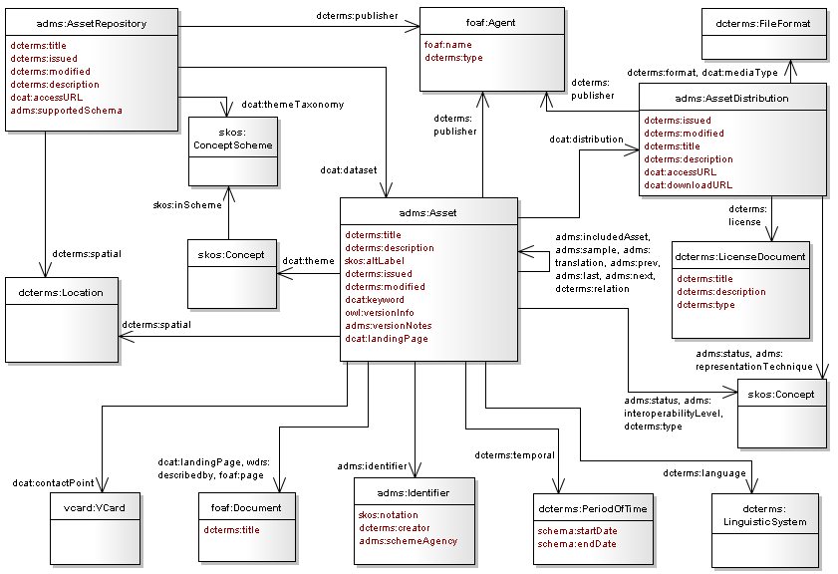



ISA work on developing common specifications for public administrations
ADMS and federation of semantic assets repositories
Core Vocabularies
DCAT Application Profile

Slide 25
How to federate existing sources of semantic specifications?
Common template (metadata) for describing semantic standards
Asset Description Metadata Schema (ADMS)
Developed by the ISA Programme
May 2012: Endorsed by the EU member states (ISA Coordination Group)

Slide 26


ADMS implementation
Since January 2013
ADMS-based federation of semantic standards repositories
Catalogue of semantic standards
Semantic standards are described using ADMS
Features simple and advanced search of semantic standards
2000+ semantic standards from 25 repositories are currently searchable through Joinup (Sep. 2013)

Slide 27
DIGIT/ISA work on developing common specifications for public administrations
ADMS and federation of semantic assets repositories
Core Vocabularies
DCAT Application Profile

Slide 28


Core vocabularies
Core Vocabularies
Simplified, re-usable, generic and extensible data models that capture the fundamental characteristics of a data entity in a context-neutral fashion.

Slide 29

Usage
Core Vocabularies
  New systems: As default starting points for data modeling
  Existing systems:
    As reference data models for integration and information sharing
    As export specifications for publishing open data

Slide 30


Core Vocabularies specs
Core Vocabularies are available through the Join.up platform since April 2012
Available in
…and
Core Vocabularies have been endorsed by the member states in the context of the ISA Coordination Group, May 2012
License
ISA Open Metadata License v1.1
https://joinup.ec.europa.eu/category/licence/isa-open-metadata-licence-v11
Notes:
30

Slide 31



Open Data:
the European Perspective
Shared initiative ...
59 Working Group members representing:
  16 different European Member States (UK,IT,ES,DK,NO,DE,SK,BE,AT,SE,FI,FR,IE,NL,GR,SI )
  US
  Several European Institutions and international organisations
  40 different Data Portals
The DCAT Application profile (DCAT-AP) is a common template to describe public sector datasets and data catalogs
Notes:
31

Slide 32
Standardisation
Information and Contact
Web sites:
http://ec.europa.eu/enterprise/policies/european-standards/standardisation-policy/index_en.htm
http://ec.europa.eu/enterprise/sectors/ict/standards/index_en.htm
e-Mail:
entr-ket-and-ict@ec.europa.eu
francisco.garcia-moran@ec.europa.eu

Slide 33



Information and Contributions Online
ec.europa.eu/enterprise
http://www.youtube.com/euenterprise
@EU_enterprise
EU Enterprise

Slide 34

Muchas Gracias

