Slide 1


XBRL
(eXtensible Business Reporting Language)
Estándar XBRL en Europa
Ignacio Boixo
CEN workshop on XBRL, Chair
boixo@bde.es
Jornada XBRL y estándares en Europa
Lunes 18 de Noviembre 2013
Madrid

Slide 2
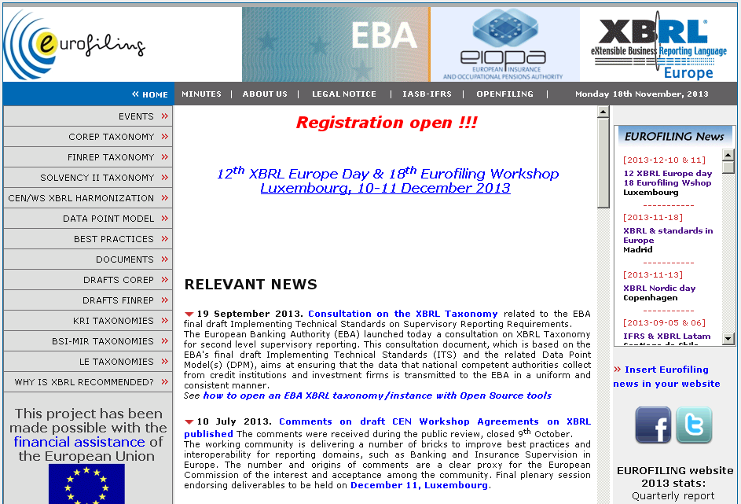
www.eurofiling.info

Slide 3
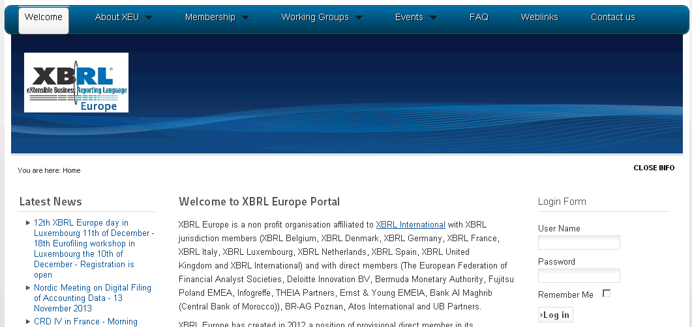
XBRL Europe

Slide 4
CEN Workshop XBRL
Improving transparency in financial and business reporting
Best practices and interoperability for reporting domains, such as Banking and Insurance Supervision in Europe, are the goals of the following CEN project deliverables:
CWA1, headed by Katrin Heinze (Bundesbank, Deutschland)
CWA1-1 European data point methodology
CWA1-2 Guidelines for data point modeling
CWA1-3 European XBRL Taxonomy Architecture
CWA1-4 European Filing Rules
CWA2, headed by Emile Bartolé (Comm. Surveillance Secteur Financier, Luxemb.)
CWA2 Metadata container
CWA3, headed by Aitor Azcoaga (European Insurance & O. P. Authority, Europe)
CWA3-1 XBRL Supervisory Roll-out Guide
CWA3-2 XBRL Handbook for Declarers

Slide 5
Nordic
Anglo-Saxon
Germanic
Southern European
Other

Slide 6

Identifying explanatory factors
Nordic
+
+
% of GDP in R&D
+
GDP per capita
+
-
-
Other

Slide 7
GRACIAS
Ignacio Boixo
CEN workshop on XBRL, Chair
boixo@bde.es
Jornada XBRL y estándares en Europa
Lunes 18 de Noviembre 2013
Madrid

